Slide 1
Flipkart project

Slide 2
Submission
ipynb file
video – atleast 7mins ..
Zoom , Loom, OBS Studio..
10th July

Slide 3
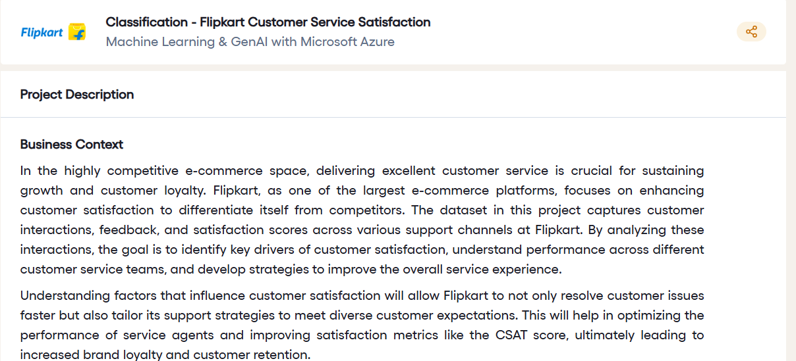

Slide 4
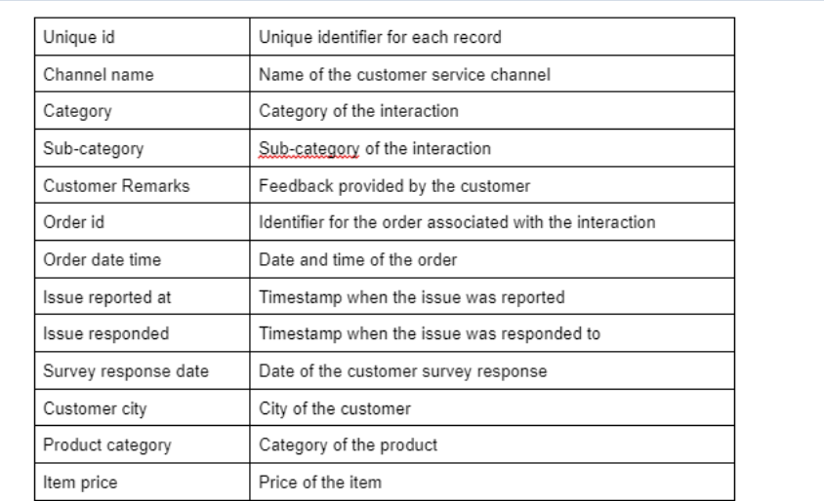

Slide 5
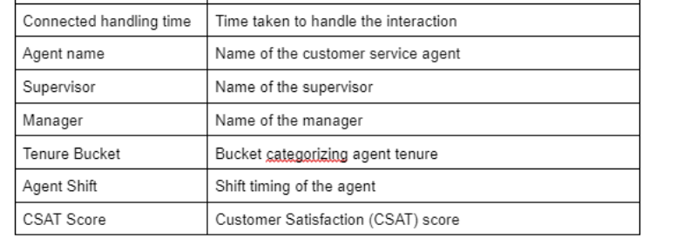

Slide 6
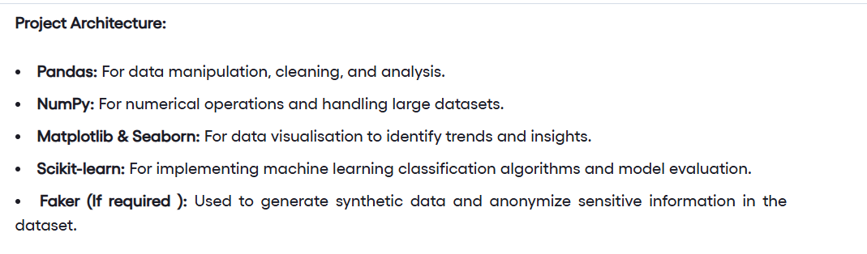

Slide 7
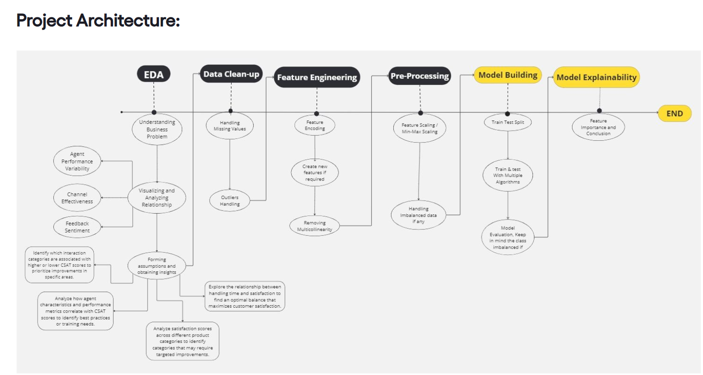

Slide 8
